Slide 1
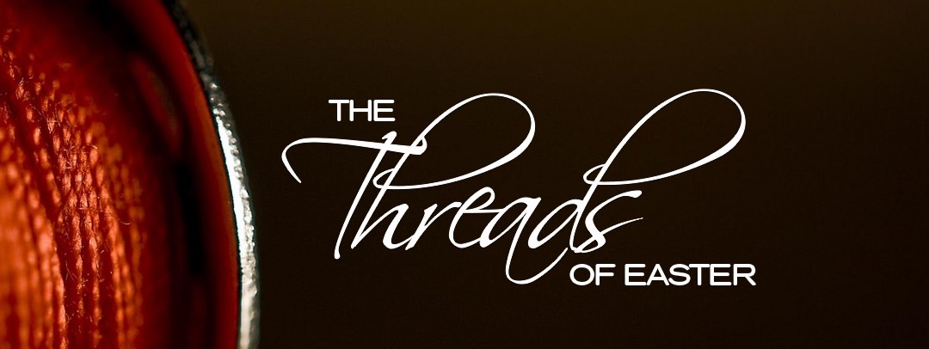
Emptiness: Where are the Figs?
Mark 11:12-14, 19-25
Matthew 21:18-22

Slide 2
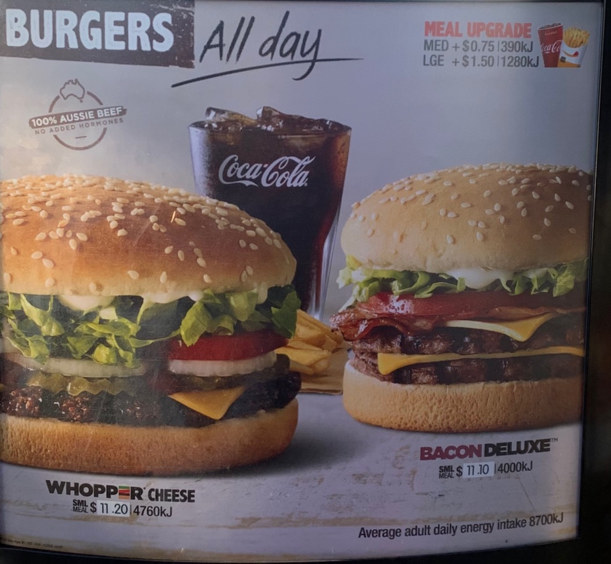

Slide 3
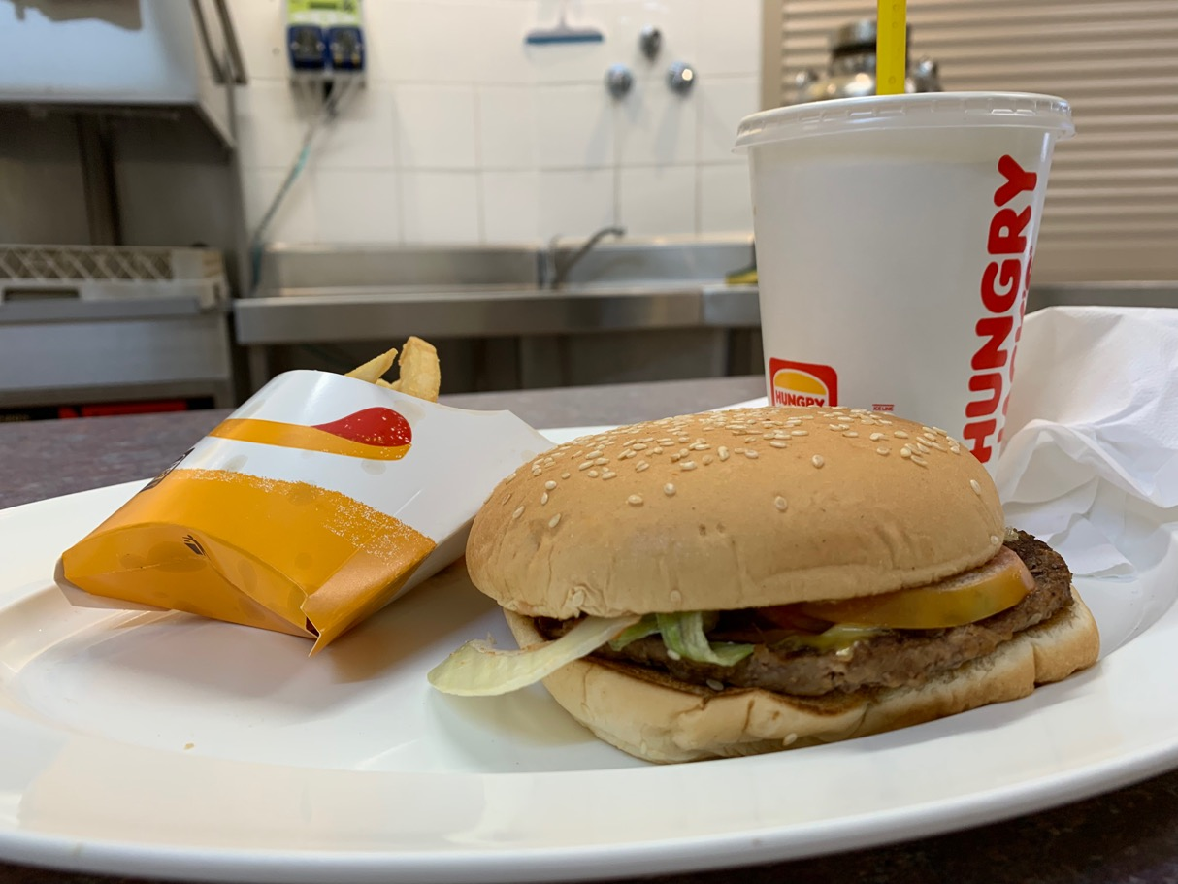

Slide 4
Mark 11:12-14
¹² The next day as they were leaving Bethany, Jesus was hungry. ¹³ Seeing in the distance a fig tree in leaf, he went to find out if it had any fruit. When he reached it, he found nothing but leaves, because it was not the season for figs. ¹⁴ Then he said to the tree, “May no one ever eat fruit from you again.” And his disciples heard him say it.
(Mark 11:15-19 - Jesus Clears the Temple)

Slide 5
Mark 11:20-25
²⁰ In the morning, as they went along, they saw the fig tree withered from the roots. ²¹ Peter remembered and said to Jesus, “Rabbi, look! The fig tree you cursed has withered!”
²² “Have faith in God,” Jesus answered. ²³ “Truly I tell you, if anyone says to this mountain, ‘Go, throw yourself into the sea,’ and does not doubt in their heart but believes that what they say will happen, it will be done for them. ²⁴ Therefore I tell you, whatever you ask for in prayer, believe that you have received it, and it will be yours. ²⁵ And when you stand praying, if you hold anything against anyone, forgive them, so that your Father in heaven may forgive you your sins.”

Slide 6
Matthew 21:18-22
¹⁸ Early in the morning, as Jesus was on his way back to the city, he was hungry.¹⁹ Seeing a fig tree by the road, he went up to it but found nothing on it except leaves. Then he said to it, “May you never bear fruit again!” Immediately the tree withered.
²⁰ When the disciples saw this, they were amazed. “How did the fig tree wither so quickly?” they asked.
²¹ Jesus replied, “Truly I tell you, if you have faith and do not doubt, not only can you do what was done to the fig tree, but also you can say to this mountain, ‘Go, throw yourself into the sea,’ and it will be done. ²² If you believe, you will receive whatever you ask for in prayer.”

Slide 7
The Fig Tree: Israel’s Spirituality
“In days to come Jacob will take root, Israel will bud and blossom and fill all the world with fruit.” (Isaiah 27:6)
but then…
“What misery is mine! I am like one who gathers summer fruit at the gleaning of the vineyard; there is no cluster of grapes to eat, none of the early figs that I crave.” (Micah 7:1)
“I will take away their harvest, declares the Lord. There will be no grapes on the vine. There will be no figs on the tree, and their leaves will wither. What I have given them will be taken from them.” (Jeremiah 8:13)

Slide 8
The Fig Tree: Israel’s Spirituality
“When I found Israel, it was like finding grapes in the desert; when I saw your ancestors, it was like seeing the early fruit on the fig tree. But when they came to Baal Peor, they consecrated themselves to that shameful idol and became as vile as the thing they loved…
Ephraim is blighted, their root is withered, they yield no fruit…” (Hosea 9:10, 16)

Slide 9
The Fig Tree: Israel’s Spirituality
“When I found Israel, it was like finding grapes in the desert; when I saw your ancestors, it was like seeing the early fruit on the fig tree. But when they came to Baal Peor, they consecrated themselves to that shameful idol and became as vile as the thing they loved…
Ephraim is blighted, their root is withered, they yield no fruit…” (Hosea 9:10, 16)
Jesus was re-enacting Israel’s history by cursing the fig tree.

Slide 10
Jesus cursed the fig tree for its deception. It was all leaves and no fruit. Jesus was judging the spiritual emptiness he had been witnessing

Slide 11
Mark 11:15-18
¹⁵ On reaching Jerusalem, Jesus entered the temple courts and began driving out those who were buying and selling there. He overturned the tables of the money changers and the benches of those selling doves, ¹⁶ and would not allow anyone to carry merchandise through the temple courts. ¹⁷ And as he taught them, he said, “Is it not written: ‘My house will be called a house of prayer for all nations’? But you have made it ‘a den of robbers.’”
¹⁸ The chief priests and the teachers of the law heard this and began looking for a way to kill him, for they feared him, because the whole crowd was amazed at his teaching.

Slide 12
Activity vs Impact Beware of emptiness masking itself: the thick lush leaves

Slide 13
Producing Spiritual Fruit Starts and ends with dependence on the Father

Slide 14
John 15:1-5
¹ “I am the true vine, and my Father is the gardener. ² He cuts off every branch in me that bears no fruit, while every branch that does bear fruit he prunes so that it will be even more fruitful. ³ You are already clean because of the word I have spoken to you. ⁴ Remain in me, as I also remain in you. No branch can bear fruit by itself; it must remain in the vine. Neither can you bear fruit unless you remain in me.
⁵ “I am the vine; you are the branches. If you remain in me and I in you, you will bear much fruit; apart from me you can do nothing.

Slide 15
Mark 11:20-25
²² “Have faith in God,” Jesus answered. ²³ “Truly I tell you, if anyone says to this mountain, ‘Go, throw yourself into the sea,’ and does not doubt in their heart but believes that what they say will happen, it will be done for them. ²⁴ Therefore I tell you, whatever you ask for in prayer, believe that you have received it, and it will be yours. ²⁵ And when you stand praying, if you hold anything against anyone, forgive them, so that your Father in heaven may forgive you your sins.”

Slide 16
The withered fig tree reminds us: It’s one thing to lack fruit out of season, it’s another thing to lack it while pretending to have it.

